Slide 1

Plymouth Training
Dr Clare Pettinger
Zoe Nile

Slide 2
Outline of training
Introduction – Plymouth SugarSmart vision
Sugar consumption and Health
Plymouth Sugar Smart aims and objectives Sugar messaging
Break
How to be a Sugar smart Ambassador
Sugar Smart Ambassador network
Next Steps

Slide 3
Aims of today
  Understand what it is to be a Sugar Smart Ambassador
  Learn the key messages of the campaign
  Find out where to get resources
  Explore what actions you can take
  Make links with others championing Sugar Smart

Slide 4
#SugarSmartPlymouth
Vision
Using Food Plymouth CIC as a central connecting platform, we will facilitate a local ‘train the trainer’ style Sugar Smart ambassador programme that will involve four primary cross-sector partners with support from secondary partners from the Food Plymouth Network
We want Plymouth to become a Sugar Smart City and create a food environment which encourages healthy choices and reduces the promotion of foods high in free sugars.

Slide 6
Introduce yourselves
What issues are you most interested in?

Slide 7
Sugar consumption and Health
Which sugars do you think we should be concerned about for general health?
Sugar in fruit
Sugar in milk products
Processed/added sugar
Why?

Slide 8






Overweight and obesity among adults
Health Survey for England 2012 to 2014 (three-year average)
Almost 7 out of 10 men are overweight or obese (66.4%)
Almost 6 out of 10 women are overweight or obese (57.5%)
Adult (aged 16+) overweight and obesity: BMI ≥ 25kg/m²
Notes:
Prevalence of overweight and obesity among adults, Health Survey for England 2012 to 2014 (three-year average)
The published Health Survey for England data used to produce this graphic are available from: http://www.hscic.gov.uk/catalogue/PUB19295
Overweight and obesity
heart disease, type 2 diabetes, stroke and some cancers
Malnutrition

Slide 9








Prevalence of excess weight among children
National Child Measurement Programme 2014/15
One in five children in Reception is overweight or obese (boys 22.6%, girls 21.2%)
One in three children in Year 6 is overweight or obese (boys 34.9%, girls 31.5%)
Child overweight (including obesity)/ excess weight: BMI ≥ 85th centile of the UK90 growth reference
Notes:
The National Child Measurement Programme (NCMP) measures and records the height and weight of over one million children (aged 4-5 and 10-11 years) each year.
Reception age 4-5 years. Year 6 age 10-11 years.
National Child Measurement Programme data source: Health and Social Care Information Centre http://www.hscic.gov.uk/ncmp

Slide 10
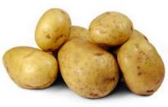
Why – Glycaemic Load
Drinking too many high-sugar beverages has been found to increase the risk of developing type 2 diabetes
Different types of carbohydrates will affect blood sugar at different rates
  Some will cause a spike in sugar
  Some will release sugar slowly
This concept is known as the glycaemic index (GI)
This effects:
  Diabetes control
  Feeling tired
  Poor regulation of appetite
  Weight
Notes:
Energy levels – glycaemic load

Slide 11
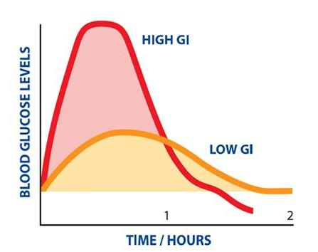
The Glycaemic Index

Slide 12


Why – Tooth decay
The NHS spent £30 million on hospital based tooth extractions in 2012-13
Notes:
Tooth decay and oral health issues
Mental health issues

Slide 13

Recommended intakes?
No more than 30g of free sugars a day
Guess how many teaspoons this is?
7
Free sugars are those added to food (e.g. sucrose (table sugar), glucose) or those naturally present in honey, syrups and unsweetened fruit juices, but exclude lactose in milk and milk products.
SACN 2015. Carbohydrates and Health.

Slide 14
Sugar consumption and health
‘Free’ sugars recommendation - <5% of total energy.
Current average intake is 15.6% of total energy-three times the recommended amount in adolescents and 12.1% twice the recommended level in adults
Soft drinks are largest single sources of sugar for children
Association with deprivation (lowest income = highest consumers)
(PHE 2015, Sugar Reduction The evidence for action)

Slide 15
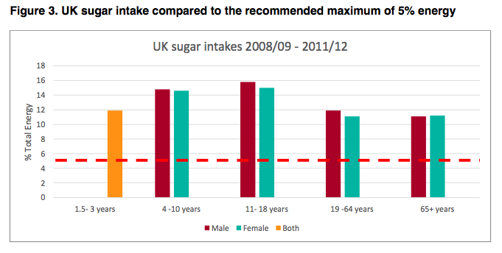

Slide 16
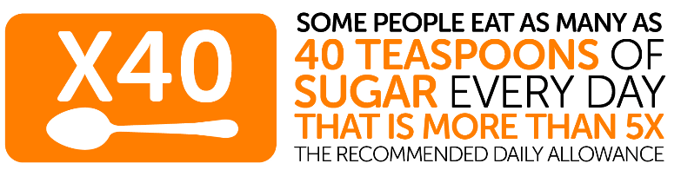

Slide 17

Local Context - Plymouth

Slide 18
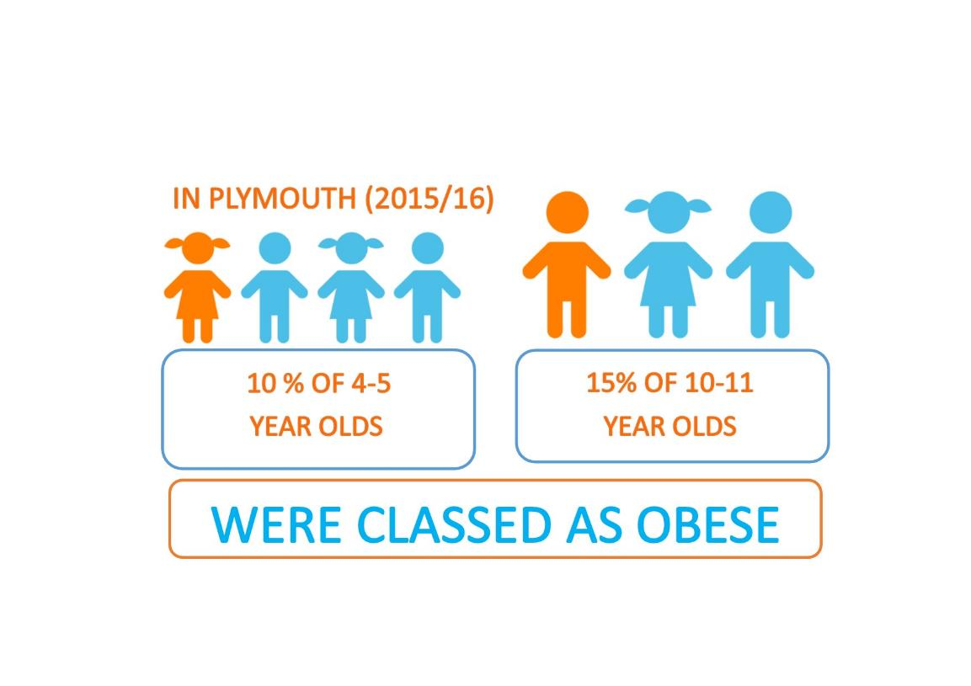

Slide 19
Tips to Cut Down on Sugar
Instead of sugary fizzy drinks or sugary squash, go for water, lower-fat milks, or sugar-free, diet and no added sugar drinks.
  Limit the amount of fruit juice to no more than 150ml a day.
If you prefer fizzy drinks, try diluting fruit juice with sparkling water.
If you take sugar in hot drinks or add sugar to your cereal, gradually reduce the amount until you can cut it out altogether.
Rather than spreading jam, marmalade, syrup, treacle or honey on your toast, try a lower-fat spread, sliced banana or lower-fat cream cheese instead.

Slide 20
Tips to cut down on Sugar
Try halving the sugar you use in your recipes – it works for most things except jam, meringues and ice cream.
Choose tins of fruit in juice rather than syrup.
Choose wholegrain breakfast cereals, but not those coated with sugar or honey.
Check nutrition labels to help you pick the foods with less added sugar, or go for the lower-sugar version.

Slide 21
Traffic Light Labelling
Food:
Text | LOW | MEDIUM | HIGH
Colour code | Green | Amber | Red
Fat | 3.0g or less per 100g | 3.0g to 17.5g per100g | More than 17.5g per 100g | More than 21g per portion
Saturated Fat | 1.5g or less per100g | 1.5g to 5.0g per 100g | More than 5.0g per 100g | More than 6.0g per portion
(Total) Sugars | 5.0g or less per 100g | 5.0g to 22.5g / per100g | More than 22.5g per 100g | More than 27g per portion
Salt | 0.3g or less per 100g | 0.3g to 1.5g per 100g | More than 1.5g per 100g | More than 1.8g per portion

Slide 22

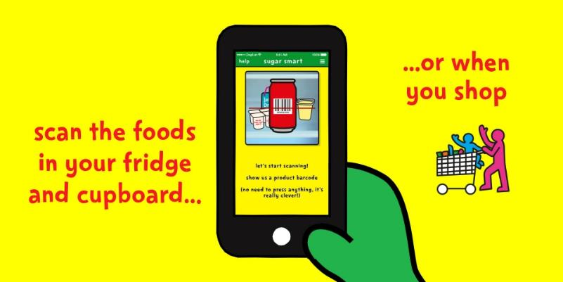
Be Food Smart App

Slide 23
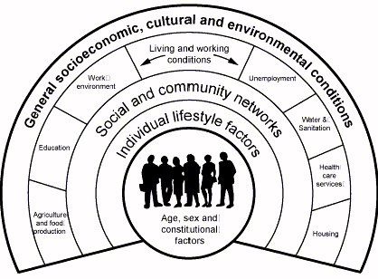

Wider determinants of Health
Notes:
Health Inequalities

Slide 24
#SugarSmartPlymouth aims to:
Raise awareness and increase understanding amongst Plymouth communities and organisations about the detrimental effects of excess sugar
Support and encourage local organisations to create a more ‘Sugar Smart’ mind-set and food environment and sign a pledge of commitment
Strengthen local cross-partner alliances. By aligning with and building on already existing local networks and strategies, this campaign will provide consolidation and aide longevity for future campaigns.
Notes:
Using official ‘Sugar Smart’ guidance to support increased availability of drinking water and healthier alternatives, reduction of sugary products at tills, fostering a ‘Sugar smart’ approach to procurement
Working with regional partners (Exeter and Bristol) to build capacity for South West Sugar Smart campaign that will be evaluated using robust standardised evaluation tools.
This approach has its roots in community development because it engages wider communities through already trusted champion organisations. We want to create a participatory feel to the campaign, encouraging co-creation and shared learning. The campaign will influence strategic leverage points within the food system and food environment, by targeting the ‘4 As’ that influence sugar consumption (Availability; Affordability; Acceptability and Awareness)

Slide 25
#SugarSmartPlymouth objectives are:
To set up a steering group consisting of key partners who are already part of the Food Plymouth network to act as ‘champions’ for the Sugar Smart campaign
To run a ‘Sugar Smart ambassador’ programme (in partnership with Exeter?), securing volunteers via each partner organisation, that will be tasked with cascading key message
Via ambassadors, to work with organisations to identify ‘Sugar Smart’ pledges that they can make (info/assets provided via main website)
Our targets are shown in figure

Slide 26
Local targets – ambassador action
‘Sugar Smart ambassador’ programme securing volunteers via each partner organisation, that will be tasked with cascading key message
Via ambassadors, to work with organisations to identify ‘Sugar Smart’ pledges that they can make (info/assets provided via main website)
  Workplaces (via PH and Livewell)
  Universities
  Schools
  Leisure
  Other

Slide 27
#SugarSmart messaging
Exeter and Plymouth’s Key Campaign Messages
Too much ‘free’ sugar is a major health concern and children currently consume triple the recommended amount.
Small changes to the way that food is provided, presented and advertised can make a big difference to consumer health and behaviour.
Consumers are aware of healthy eating messages and there is increasing media attention.
Consumers want to change their behaviour to improve their diet, but need the environment to support them to do so. We need to make healthy food and drink more accessible and affordable.

Slide 28
Core principles for SugarSmart
“Free” sugar is any sugar that is added to foods at home or by the producer, plus sugar naturally present in honey, syrups, and fruit juices. It does not include sugar naturally present in milk or whole fruit and vegetables.
We encourage people to be Sugar Smart, not Sugar Free.
This is more realistic and sustainable in the current environment.
We want to help make the healthy choice, the easy choice.
Individuals need the food environment to support healthy eating habits.

Slide 29
Activity – communicating messages
Think about the messaging for SugarSmart
Get into small groups of 3-4 people
Choose a local audience (workplace, leisure centre, university)
With this audience in mind, think about how you would reach them
What messages or core principles would you highlight?
How would you communicate these?
Come up with good (and bad) examples e.g. social media posts
Use your local knowledge and ideas

Slide 30
Break

Slide 31
How to be a Sugar Smart Ambassador?
Sugar Smart Ambassador role
Resources that are available
Steps to advocate for SugarSmart action
ACTIVITY – ideas?
Next steps

Slide 32
Sugar Smart Ambassador Role
Social movement to create healthier food environments
Actions you take are up to you – use your initiative and follow what interests you
  Any activity to promote Sugar Smart is useful, including running any stalls, events, activities within your networks.
  We do have our local targets which you can help us with if you need ideas
Actions made under the Sugar Smart branding must be in line with our core principles
Notes:
Core principles and values
Actions made - under SugarSmart branding
Voluntary positions
Commitment – it is up to you
Consent (sign in sheet)

Slide 33
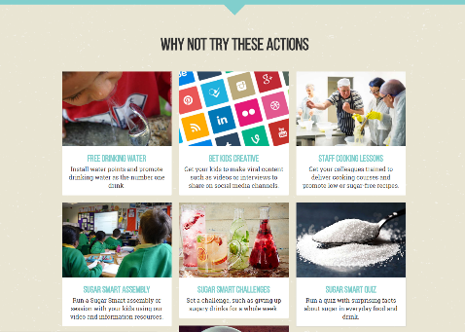
Resources available
Sugar Smart UK Website
Dashboard
Resources and assets available to download from website
https://www.sugarsmartuk.org/about/
Support from SugarSmart Team
  Clare Pettinger (Manager)
  Zoe Nile (coordinator)
  Steering group

Slide 34
Steps to Advocate for Sugar Smart Action
Pledging to be Sugar Smart
How to engage with organisations
What is the most useful way for us to share assets?

Slide 35
Key Elements for Success in Plymouth
Generate enthusiasm and purpose
Clear vision outlined from the beginning
Cross-sector partnership (Food Plymouth)
Developing relationships
Perseverance
Raising awareness of initiative locally
Allowing the campaign a certain amount of freedom to evolve

Slide 36
Challenges for Engagement
Leisure centres – profit
Conflicting sugar and health information
Sugar messages being confused - perception
  “Sugar police”
  Individual behaviour change focus
  Confusion with Be Food Smart PHE campaign
Limited resources
(Hospitals – complexity)

Slide 37
ACTIVITY - Targets in Plymouth: ambassador action
Workplaces (via PH and Livewell) – to liaise with workplaces to encourage pledges
Universities (PU & Marjon) – to work with canteens on campus
Leisure – Plymouth Argyle and other leisure centres
Schools – liasing with already engaged schools to secure pledges (e.g. Scott College and School of Creative Arts)
Other (e.g. Derriford, events - Coca Cola lorry )
Who are you interested in working with?

Slide 38

What are your next steps?
Choose your target
What changes would you like to see?
What would you do as a Sugar Smart Ambassador to encourage those changes?
What tools or resources would you need?
Feedback form – write down your ideas
Notes:
Particularly try to work with others interested in the same area

Slide 39
Other suggestions from us
Help with future Sugar Smart Ambassador training
Contacting workplaces
Social media activity
Plymouth based materials
Events (e.g. Coca Cola Truck)

Slide 40
Sugar smart ambassador network
How to keep joined up?
Physical or virtual network?
Possible options:
  Facebook group
  WhatsApp
  Face to face
  Email list?

Slide 41
Any questions?

Slide 42

www.sugarsmartuk.org
@SugarSmartPlymouth
#SugarSmartPlymouth
Zoe_Nile@outlook.com
Clare.pettinger@plymouth.ac.uk

