Slide 1




SUGAR SMART Campaign General presentation for cities, counties and other local areas wishing to go SUGAR SMART

Slide 2

Notes:
What is SUGAR SMART?
- SUGAR SMART is a campaign of Jamie Oliver and Sustain to help local areas across the UK to tackle excessive sugar consumption. We work with councils, businesses, institutions and other sectors to help reduce overconsumption of sugar in their local areas. SUGAR SMART supports local campaigns to take on a cross-sector approach to transform their food environment and raise public awareness of the impacts of consuming too much sugar.
- Whilst how much sugar we consume is ultimately down to individuals, the role of the environment we live in, from advertising and promotions, through to proliferation of sugary options is hugely influential. A vital part of SUGAR SMART UK is encouraging a multi sector approach with local businesses, organisations and residents involved. We know there is no one solution to obesity and poor diet and only a multi-pronged approach involving everyone will lead to long term change.
- We want to find those people who can coordinate campaigns in their local areas, and encourage more businesses, organisations and residents to go SUGAR SMART.

Slide 3






Jamie’s Sugar Rush Channel 4 August 2015
Notes:
In August 2015 Jamie’s Sugar Rush documentary premiered on Channel 4 and inspired action to reduce sugar overconsumption, with a focus on what local areas can do now while calling for national action on obesity and diet-related ill health.
On 16th March 2016 George Osborne announced the Sugary Drinks Tax to be rolled out in 2018, but there is much more to be done around junk food advertising, reformulation of popular sugary brands, and clearer labeling.

Slide 4


Notes:
In an effort to take action now while calling on national leadership around addressing sugar overconsumption, a pilot locally-focused multi-sectoral campaign was launched in Brighton & Hove.

Slide 5

Primary Schools
Community Groups
Secondary Schools
Tourism & Venues
Universities
Retail
Health & Hospitals
Restaurants & Catering
Workplaces
Sports & Leisure
Notes:
The B&H campaign identified 10 sectors to work with to create changes.

Slide 6


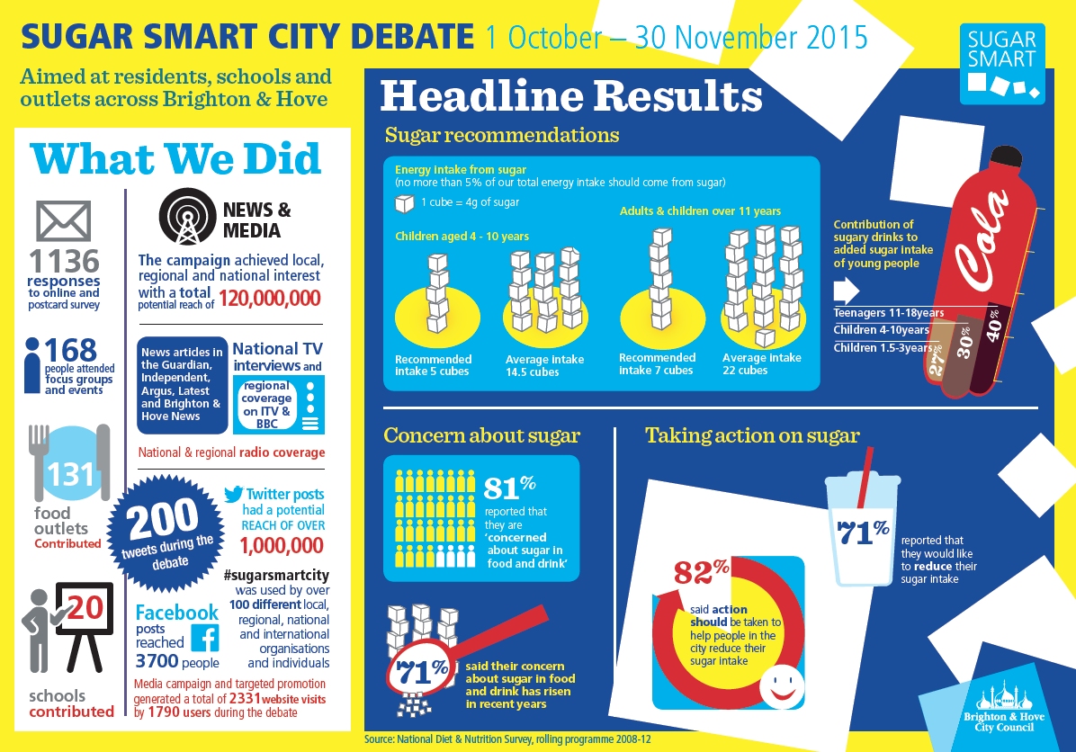
Notes:
The Pilot in Brighton & Hove
In October 2015 Brighton & Hove started a SUGAR SMART pilot with the backing of Jamie Oliver Food Foundation.
They launched this with a public debate to get the public and local businesses to say what they think could be done to make a difference.
The first stage has included events and public surveys, backed by good press coverage. Led by Brighton & Hove Council in conjunction with other partners, including the Brighton and Hove Food Partnership and the Jamie Oliver Food Foundation, they have launched a city wide campaign to raise awareness across the city of the effect consuming too much sugar can have on long term health. Successful model: Council + food partnership + Jamie Oliver Food Foundation
Over time the campaign expanded to reach many schools, businesses and University of Brighton.

Slide 7
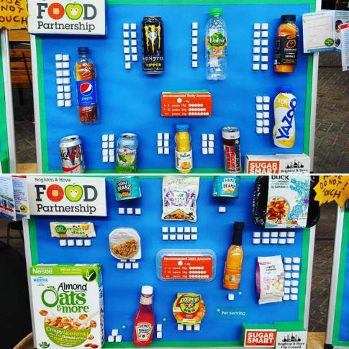
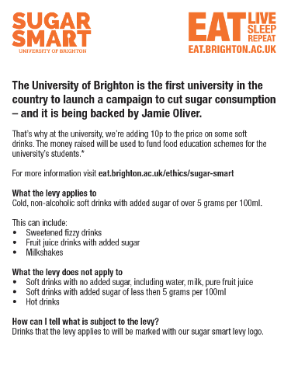
Notes:
SUGAR SMART Brighton & Hove
They have been rolling out sponsored digital food education programmes to every primary school, holding SUGAR SMART assemblies; working with the local sports centres and stadiums to introduce a levy on sugary drinks; and encouraging retail and food outlets across the city to do more to promote healthier choices. They’ve also been doing events, such as sports days, to promote SUGAR SMART.
Events are being held over the next year to support teachers and promote healthier breakfast clubs.
University of Brighton introduced a voluntary sugar levy in September 2016. This had an impact in the sale of sugary drinks. Sales of sugary drinks are down 16%. The money raised is being used to fund food education schemes for the university’s students. The university is also planning to raise awareness of sugar consumption through cooking lessons, education and nutrition information in the academic year 2016/17.

Slide 8

Notes:
SUGAR SMART Lewisham
October 2016 Lewisham, the first London borough to run the SUGAR SMART campaign, has been joined by 20 local organisations including a schools’ caterer, an NHS Trust and a football club.
In Lewisham, one in every four children is obese or overweight by the time they start secondary school, which is higher than the national average. In a move to tackle this level of obesity, Lewisham has become the first London borough to go SUGAR SMART. The Council is working with local businesses and organisations, including schools, children’s centres and hospitals, to promote healthier, lower-sugar alternatives and to limit less healthy options.
Chartwells, a major catering firm that supplies many Lewisham schools, will be producing healthier school meals and reducing the sugar content in their popular desserts. Student councils in Lewisham are also working towards making changes in their schools.
Millwall Football Club goes SUGAR SMART
Millwall Football Club has agreed to introduce a sugar tax of 10p across the stadium, and in all their catering outlets. Proceeds will go to the Millwall Community Trust to develop a food, exercise and healthy lifestyle programme for children in local schools.

Slide 9
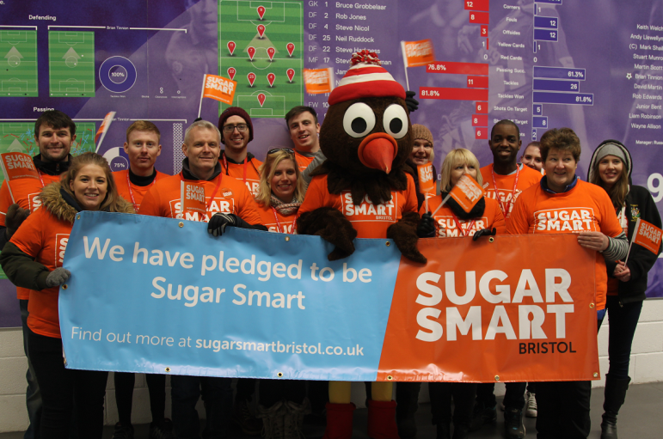
Notes:
SUGAR SMART Bristol
Campaign launch in January 2017 over one weekend during football and rugby matches. Bristol Sport Foundation is supporting the campaign and delivering health and wellbeing programmes in schools.
Ashton Gate Stadium (home of Bristol City Football Club) introduced a healthy option concession on match days, with 8% increase in fans taking up healthy options.
University of the West of England has taken action to reduce sugary drinks by making water and non-sugary drinks cheaper, as well as raising awareness. It saw:
5% reduction in sales of sugary drinks
13% increase in sales of non-sugary drinks
8% increase in the sale of water

Slide 10
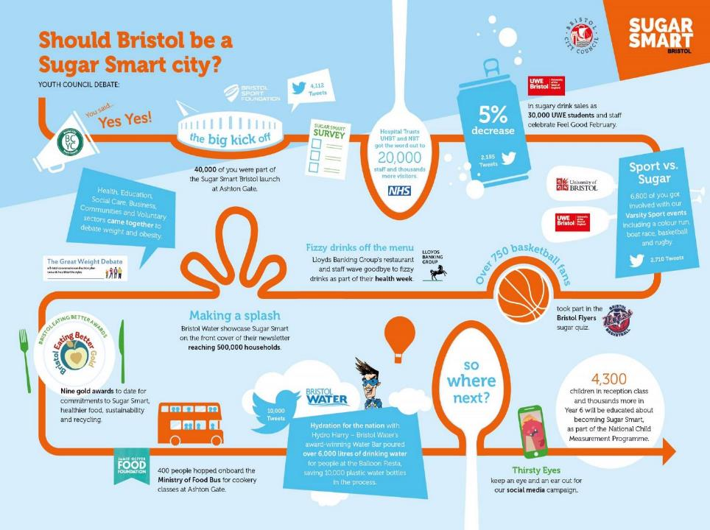
Notes:
SUGAR SMART Bristol
Bristol focussing its next phase of work on engaging young people on sugar reduction, working with schools and running a social media campaign.

Slide 11
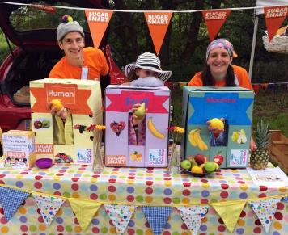
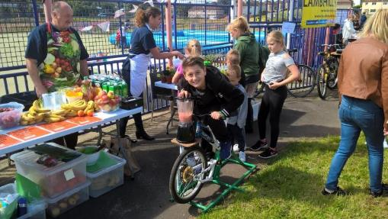
Notes:
SUGAR SMART Bath & North East Somerset
- BANES held Radstock and Westfield community launches. They teamed up with Virgin Care to engage with residents. They built a Human Fruit Machine to make public engagement fun and family-friendly. People played the game and won real fruit. Over 500 people attended and took part.
SUGAR SMART Glasgow
- Focus on Milton area, where rates for obesity and being overweight are above Scottish average. Similar approach as above to make public engagement fun and family-focused.

Slide 12
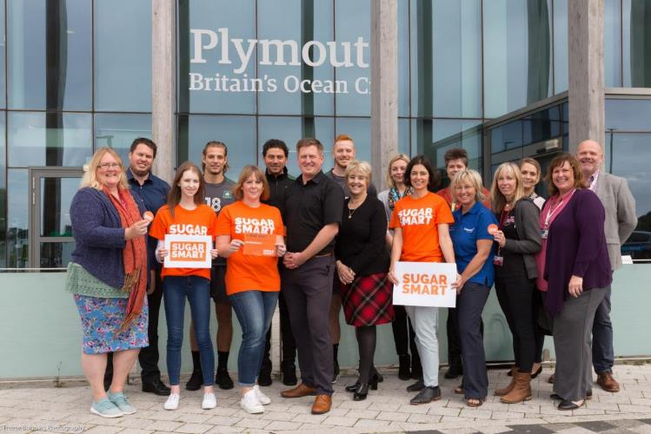
Notes:
SUGAR SMART Plymouth & Everyone Active Launch
Everyone Active announced their collaboration with SUGAR SMART and pledged to remove more than three tonnes of sugar from its food and beverage products over the next three years. Joint launch with SUGAR SMART Plymouth.
“It is brilliant to have officially launched our national pledge. We have already been doing a lot of work to make our food and beverage options healthier, and it’s great to formally recognise this with the Sugar Smart stamp.” Andy Coupé, Everyone Active’s group food and beverage manager

Slide 13
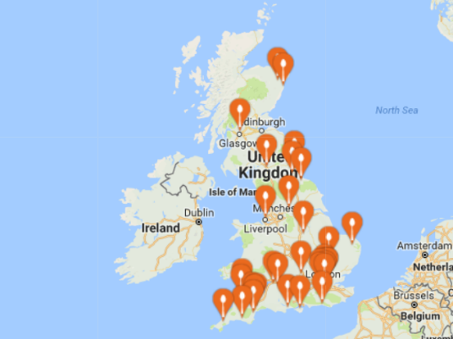
Notes:
- Huge interest up and down the country to replicate these models of working.

Slide 14






















Notes:
(As of March 2018) 22 campaigns have now launched.

Slide 15
CAMPAIGNS UPDATE
22 campaigns have launched
23 more in development stages
Over 700 sector participants taking action
16 Sustainable Food Cities grants awarded to local food partnerships running SUGAR SMART campaigns
Notes:
(As of March 2018) 22 campaigns have launched, a further 23 are in development and already making changes, and another 14 are expressing interest.
There are over 700 participating organisations, businesses and settings that have signed up to the campaign, with most having already committed to and making changes to reduce sugar overconsumption in their areas.
Please see end of this presentation for more info about the Sustainable Food Cities Network and how to access their free support.

Slide 16


Primary schools
Secondary schools
Universities
Hospitals
Workplaces
Sports & leisure
Restaurants
Retail
Tourism & venues
Community groups
Notes:
10 sectors to target
The campaign focuses on action across ten sectors to tackle excessive sugar consumption. We expect you will choose a handful of sectors that are priorities for you locally. Under each sector there is a proposed menu or ‘shopping list’ of actions that participants, e.g. businesses or organisations can choose from.

Slide 17
For local campaign leads:
Step 1 – Register your interest in running a local campaigns at www.sugarsmartuk.org
Step 2 – Identify your priority areas and sectors to target
Step 3 – Launch your campaign & promote the sectors taking action
Step 4 – Develop next steps and keep going!
Notes:
The steps to become a SUGAR SMART area
Step 1 – Register your interest in running a campaign at sugarsmartuk.org
We get a notification
Download campaign handbook, PPT
Support over the phone from Sustain: discuss your local needs, advise on options for pursuing campaign activities and overcoming common challenges.
Localised campaign logo
Step 2 – Gather support and identify priorities
Who to involve in the steering group? Combination of Public Health, partnership and community organisations and businesses has been successful in steering existing campaigns.
This core group will determine the vision for the campaign and workplan
Who to involve in the delivery? A much wider group of organisation and businesses. They will be the ones you target to reduce sugar. Depending on the objectives of your local campaign you need to identify who are the major targets for your campaign in the sectors you wish to influence.
Step 3 – Make a public announcement and celebrate!
Sustain can be at the launch to represent the national campaign. Message of support from Jamie Oliver.
Involve the media, spread the word. Celebrate early adopters and sign ups.
Step 4 – Keep going!
Use the website to recruit new participants.
Every new sign up is a new press release. Lewisham for example has a regular presence in the local press and that helps to recruit new businesses to the campaign.

Slide 18
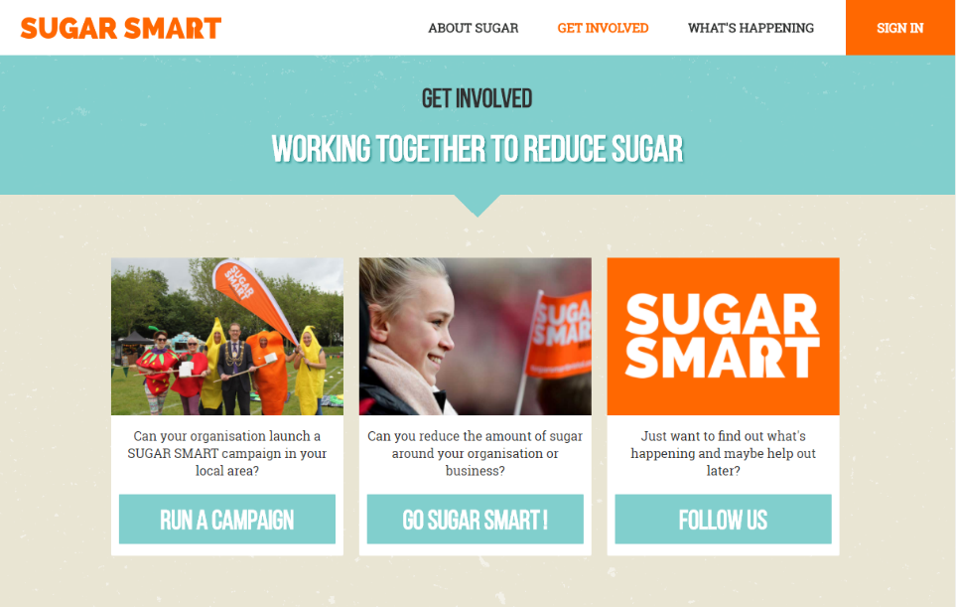
Notes:
Our SUGAR SMART website:
Central campaign platform
Database of resources
Log of local action and impact
Partner dashboard (for campaign leads)
Participant dashboard (for organisations making changes and running activities)
Prospective local campaign leads (partners) can RUN A CAMPAIGN
Organisations, institutions and businesses looking to transform their food environments and/or run public engagement campaigns can GO SUGAR SMART
Individuals interested in learning more, getting inspired and spreading the word can FOLLOW US on twitter, facebook or via our monthly newsletter

Slide 19
For local participating sectors:
Step 1 – Register your organisation, setting or business on www.sugarsmart.org
Step 2 – Pledge action(s) and do it
Step 3 – Publicise your SUGAR SMART actions
Step 4 – Keep going!
Notes:
The steps to become a SUGAR SMART setting/participant
Step 1 – Register your organisation, setting or business on www.sugarsmart.org
Sustain and your local campaign lead get notified.
Liaise with your local campaign lead on your plans and receive support to take action on sugar reduction.
Utilise our campaign resources, activities, case studies and assets specific to your local campaign to help you in your journey.
Step 2 – Pledge your action and do it
Choose from a number of actions for your sector to reduce the prevalence of sugar in your environment and to engage your community on sugar reduction.
Once your action is rolled out, update the dashboard with the impact made (for example, number of people reached, or number of points of sale improved)
Step 3 – Publicise your SUGAR SMART actions
Promote the changes you are making. Engage with local media to publicise your actions.
Communicate what you are doing within your wider community (employees, customers, students, parents, clients, etc.)
Step 4 – Keep going!
Build on your success to choose other areas of improvement.

Slide 20

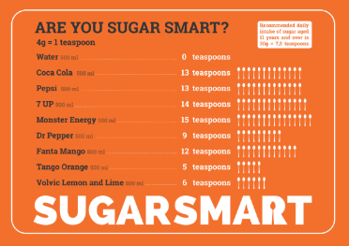
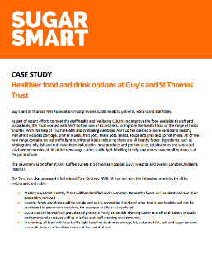
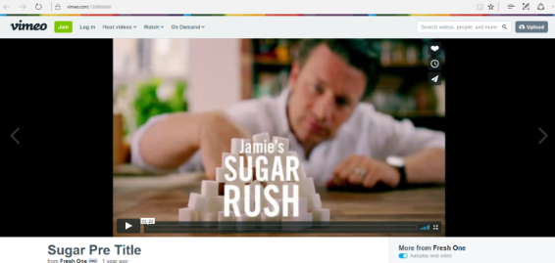
Notes:
Under each action, the campaign provides assets to support you and participants to take action to tackle sugar consumption and raise awareness: case studies, films, examples from existing SUGAR SMART campaigns, lesson plans, posters, etc.

Slide 21
For individuals & campaign supporters:
Sign up to receive the newsletter
Sign up as a volunteer
Get others on board
Notes:
Individuals can take action too, by connecting with the campaign and asking businesses and organisations in their local community to join.

Slide 22
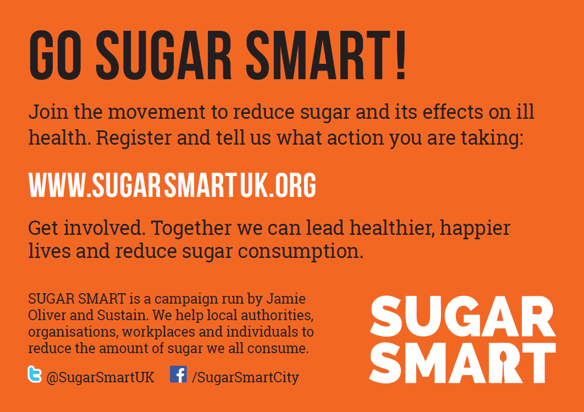
Notes:
Our generic flyer which you can print out and take to places you want to get involved.

Slide 23

Register on the site
Keep in touch
We’re here to help!
Notes:
Get involved, get in touch, share your plans and actions. Let’s work together and take action to reduce sugar overconsumption and its effects on the health and wellbeing of our communities.

Slide 24
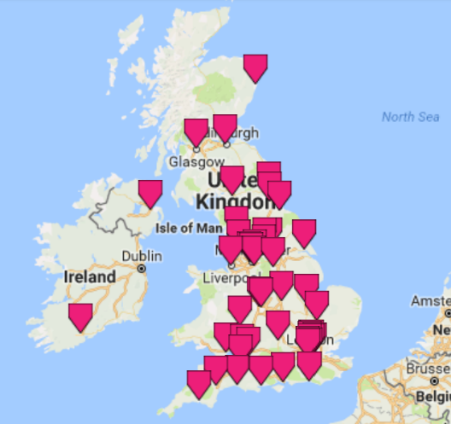

www.sustainablefoodcities.org
Notes:
FEATURE CAMPAIGN OF SUSTAINABLE FOOD CITIES UNTIL MID 2018
Sustainable Food Cities is a movement of 51 towns, cities, boroughs and counties that share the same approach for transforming food and food culture. The Sustainable Food Cities approach is about…
Establishing an effective cross-sector food partnership of key stakeholders (public agencies, businesses, NGOs, academics)
Incorporating healthy and sustainable food into local policy, strategy and planning
Developing and delivering a food strategy and action plan to tackle key food challenges in the local area.
The Sustainable Food Cities approach is a tried and tested model for driving positive change.
Different levels of involvement depending on where your area is in its journey:
SFC email group for sharing best practice & advice
Newsletter
Get support for developing your cross-sector food partnership
SFC membership: Network members can attend our series of regional and national events and join webinars and other learning and exchange forums. Network members can also benefit from our online resources and from support from the Sustainable Food Cities Team.
The Sustainable Food Cities Award is designed to recognise and celebrate the success of those places taking a joined up, holistic approach to food and that are achieving significant positive change on a range of key food issues.
Check out Getting the Basics Right guide as a first step.
Get in touch with Leon Ballin LBallin@soilassociation.org for more info.

Slide 25
www.sugarsmartuk.org
Sofia Parente sofia@sustainweb.org
Vera Zakharov
vera@sustainweb.org
Notes:
Thanks – contact details

