Slide 1
Notes:
What is SUGAR SMART?
SUGAR SMART is a campaign of the charity Sustain helping local areas across the UK to tackle excessive sugar consumption. We work with councils, businesses, institutions and other sectors to help reduce overconsumption of sugar in their local areas. SUGAR SMART supports local campaigns to take on a cross-sector approach to transform their food environment and raise public awareness of the impacts of consuming too much sugar.
Whilst how much sugar we consume is ultimately down to individuals, the role of the environment we live in, from advertising and promotions, through to proliferation of sugary options is hugely influential. A vital part of SUGAR SMART UK is encouraging a multi sector approach with local businesses, organisations and residents involved. We know there is no one solution to obesity and poor diet and only a multi-pronged approach involving everyone will lead to long term change.
SUGAR SMART is one of the campaigns of the Sustainable Food Cities Network. SFC is a movement of 51 towns, cities, boroughs and counties that share the same approach for transforming food and food culture. The Sustainable Food Cities approach is about establishing an effective cross-sector food partnership of key stakeholders (public agencies, businesses, NGOs, academics), incorporating healthy and sustainable food into local policy, and delivering a food strategy to tackle key food challenges in the local area.
About Sustain: Sustain advocates food and agriculture policies and practices that enhance the health and welfare of people and animals, improve the working and living environment, promote equity and enrich society and culture. www.sustainweb.org

Slide 2
Primary Schools & Early Years
Community Groups
Secondary Schools
Tourism & Venues
Universities & Higher Education
Retail
Health & Hospitals
Restaurants & Caterers
Workplaces
Sports & Leisure
Notes:
SUGAR SMART focuses on action across ten sectors to tackle excessive sugar consumption. Primary Schools & Early Years, Secondary Schools, Universities & Higher Education, Healthcare &Hospitals, Workplaces, Sports & Leisure, Restaurants & Caterers, Retail, Tourism & Venues, and Community Groups & Organisations.
Local Authorities and local Food Partnership organisations with cross-sectoral links lead on coordinating SUGAR SMART Campaigns (for example SUGAR SMART Bristol) and engage various education settings, organisations and businesses in taking part in the campaign and reducing sugar within their settings.

Slide 3
Notes:
29 campaigns are now launched and doing wonderful work engaging a variety of sectors within their communities.
Over 30 other areas are developing their campaign plans and working toward launching.
There are over 1200 participating organisations, businesses and other settings registered with SUGAR SMART and taking action. The total number of organisations taking part is well over 1200 as not everyone has registered yet!
3

Slide 4
SUGAR SMART Schools
403 Primary Schools & Early Years settings taking part
10 actions available for schools to choose from – education activities as well as school policies and improvements to the food environment.
Popular actions include assemblies, getting kids creative, healthy lunchbox policies and promoting free drinking water
Notes:
Highlights from SUGAR SMART Schools:
433 primary schools and early years settings have registered with the SUGAR SMART campaign. This sector is the most active in the SUGAR SMART Campaign, which is brilliant, as that is also where the most impact can be made on the future health outcomes of the youngest generations.
Actions that schools can take are: external accreditation or healthy schools schemes, creative activities, sugar smart quizzes, sugar-free packed lunch policy, promote water, assemblies, healthy recipe demos, sugar reduction challenges, healthy workplace schemes, and public engagement events
Popular actions include assemblies, getting kids creative, healthy lunchbox policies and promoting free drinking water

Slide 5
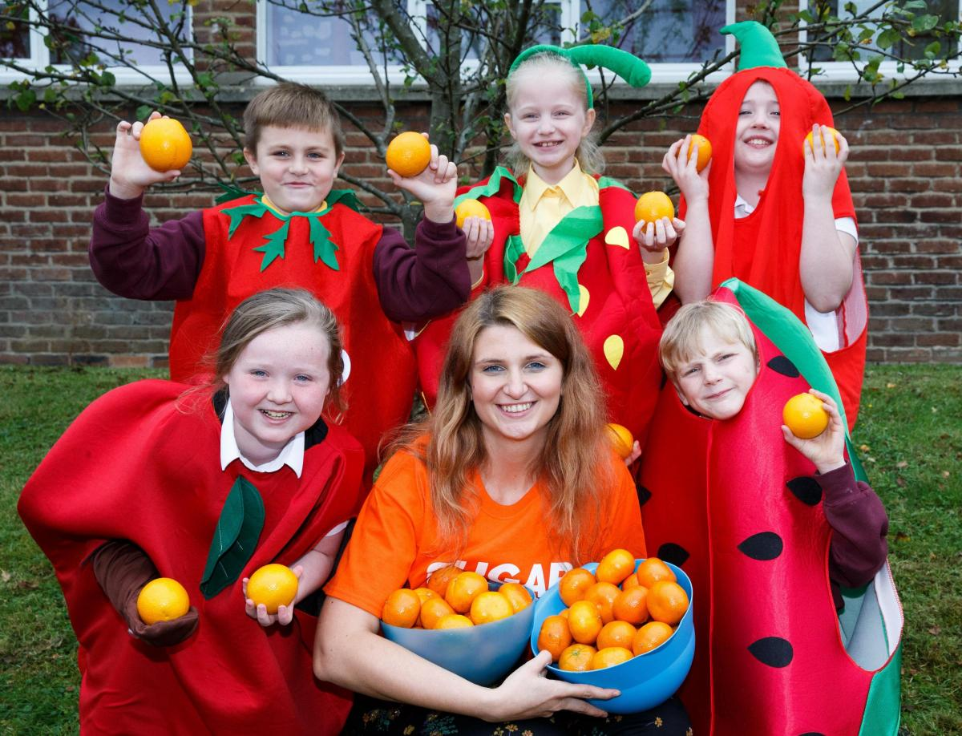
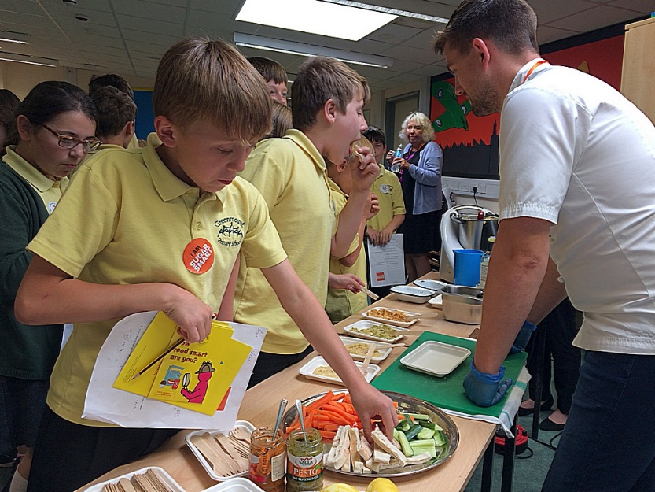
SUGAR SMART Schools
Notes:
There are plenty of brilliant examples from local schools – involving students in championing sugar reduction and designing whole school engagement activities.
Some examples of school activities as part of SUGAR SMART:
Chirnsyde Primary in Glasgow ran a SUGAR SMART festive fundraiser fayre, working with the PTA and children to offer snacks and treats that contained little to no free sugar.
Students at Heathryburn Primary in Aberdeen led on designing a Ditch the Fizz campaign aimed at supporting children, teachers and parents to reduce their sugary drink consumption.
Greenmount School in Isle of Wight hosted a Healthy Eating Day for Year 6 students to prepare them for entry into secondary school, where they designed their own healthy snacks and took on sugar reduction challenges.

Slide 6
SUGAR SMART School Caterers
We’re keen to get more school caterers going SUGAR SMART
Caterers can take part by making long term changes such as recipe improvement and getting accredited, and by engaging both staff and children on healthier food.
Notes:
SUGAR SMART School Caterers:
There are not as many school caterers involved in SUGAR SMART as of yet, although school engagement has shown that kids are ready to embrace healthier options.
The actions for school meal providers are slightly different from those available to schools and include improving the food on offer by changing recipes and portion sizes, getting external accreditation (such as FFL), training up staff and promoting healthier eating through engagement work in schools.

Slide 7
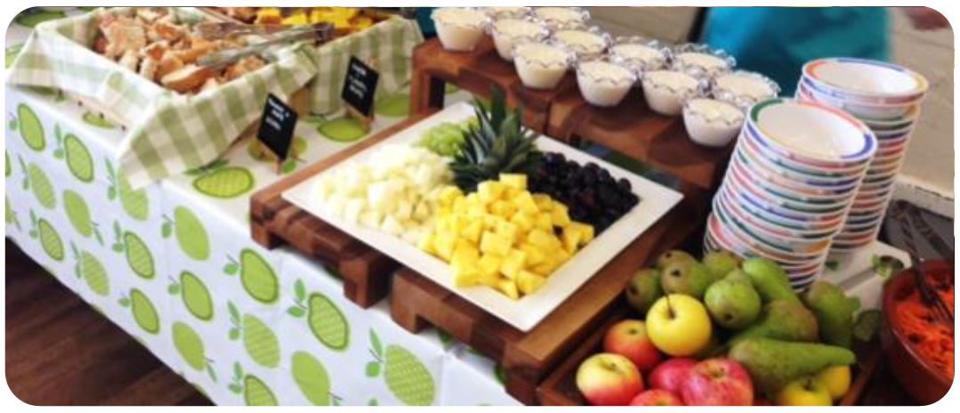
Caterlink Case Study
Worked toward total sugar limit 6.5g per meal
Changed recipes of desserts, offered sugar-free options
Ran taste test sessions with children
Total reduction across sites: 46 tonnes of sugar per term
Notes:
Caterlink’s ambitious sugar reduction project:
Caterlink joined the SUGAR SMART Isle of Wight Campaign in 2017
The caterer used Children’s Food Trust guidance on maximum sugar content in school meals. They audited their three week menu and found an average of 13g of sugar per meal. Through removal of the highest-sugar desserts from menus, recipe tweaks, and no-sugar substitutions such as plain yoghurt, they brought the meal sugar average down to an average of 4.5g, with no meal day going over 6.5g.
Caterlink encouraged more fruit & plain yoghurt only dessert days across their sites, with many trams adopting 2 per week. Another dessert option that proved popular was an apple and cheese board.
The company conducted numerous taste tests with staff and children. Amy Fox was delighted at the positive responses from children, adding: “They enjoyed trialling the new reduced sugar natural yoghurts– their favourite was the chocolate one! They also thought that the new carrot cake was tasty, light and fluffy. They were happy to have it on their menu for the next term.”
While there was a brief early period that saw a slight increase in food waste due to changes in the menu, these levels eventually went down, showing that children need time to adjust to new flavours, and in time will be enjoying the dishes as much as their previous higher sugar versions.
The sum of this reduction across all Caterlink sites in the South has resulted in a huge reduction of over 46 tonnes of sugar per term, which is the same weight as six elephants! Their sugar reduction project was very well received by local authorities commissioning school meals to the caterer – showing that healthier catering is good for business as well.

Slide 8
For local participating sectors:
Step 1 – Register your school or school caterer on www.sugarsmart.org
Step 2 – Plan what actions you will take and register them on the website
Step 3 – Publicise your SUGAR SMART actions
Step 4 – Keep going! Plan your next activities
Notes:
Can your school caterer do the same?
We invite all schools and schools caterers to join the SUGAR SMART campaign by registering on our website. Joining is free, and there are plenty of resources to help you inspire children, parents and staff to reduce their sugar overconsumption, as well as guidance and case studies for caterers looking to improve their food offer.
If there is already a local SUGAR SMART campaign in your area, make sure to stay in touch with your local coordinator to receive further support and advice on taking action as well as promoting your great work on sugar reduction.
Step 1 – Register your school or business on www.sugarsmart.org
The website will grant you access to a plethora of resources to help you make improvements in your setting and run engagements activities. You will receive monthly SUGAR SMART newsletters with inspiring projects ,
Your great work will also be counted as part of the local picture, and national picture, of changes taking place, and inform campaign work
Step 2 – Pledge your action and do it
Choose from a number of actions for your sector to reduce the prevalence of sugar in your environment and to engage your community on sugar reduction. Once your action is rolled out, update on the impact made (for example, number of people reached, or number of points of sale improved)
Step 3 – Publicise your SUGAR SMART actions
Promote the changes you are making. Communicate it with your customers/clients/community, and engage with local media to publicise your actions.
Step 4 – Keep going!
Build on your success to choose other areas of improvement.

Slide 9
Thank you!
www.sugarsmartuk.org
Vera Zakharov sofia@sustainweb.org
Sofia Parente sofia@sustainweb.org

